Slide 1
Graph

Slide 2
Contents
Overview of Graph terminology
Graph representation
Breadth first search
Depth first search
Minimum Spanning Tree
Prims
Kruskal

Slide 3
Graph
Graph is a non linear data structure, it contains a set of points known as nodes (or vertices) and set of links known as edges (or Arcs) which connects the vertices.
Generally, a graph G is represented as G = ( V , E ), where V is set of vertices and E is set of edges.

Slide 4
Background
To present the relationships between different objects/elements in a mathematical way
Examples:
  Friendship
  Local Area Network (LAN)
  Map of a country

Slide 5

Example
A graph with 5 vertices and 6 edges.
This graph G can be defined as G = ( V , E )
Where V = {A,B,C,D,E} and E = {(A,B),(A,C)(A,D),(B,D),(C,D),(B,E),(E,D)}.

Slide 6
Terminology
Vertex
A individual data element of a graph is called as Vertex. Vertex is also known as node. In above example graph, A, B, C, D & E are known as vertices.
Edge
An edge is a connecting link between two vertices. Edge is also known as Arc. An edge is represented as (starting Vertex, ending Vertex).

Slide 7
Various types of graphs
Connected/disconnected graphs
The circled subgraphs are also known as connected components

Slide 8
Various types of graphs
Directed/undirected graphs
You may treat each undirected edge as two directed edges in opposite directions

Slide 9
Various types of graphs
Weighted/unweighted graphs
5
0
-2
7
4

Slide 10
Degree
degree: number of edges touching a given vertex.
  at right: a=1, b=2, c=3, d=2
a
b
c
d

Slide 11
Paths
path: A path from vertex a to b is a sequence of edges that can be followed starting from a to reach b.
  can be represented as vertices visited, or edges taken
  example, one path from V to Z: {b, h} or {V, X, Z}
  What are two paths from U to Y?
path length: Number of vertices
or edges contained in the path.
neighbor or adjacent: Two vertices
connected directly by an edge.
  example: V and X
V
a
b
U
d
X
Z
h
c
e
W
g
f
Y

Slide 12
Reachability, connectedness
reachable: Vertex a is reachable from b
if a path exists from a to b.
connected: A graph is connected if every
vertex is reachable from any other.
  Is the graph at top right connected?
strongly connected: When every vertex
has an edge to every other vertex.
V
a
b
U
d
X
Z
h
c
e
W
g
f
Y
a
b
a
b
d
c
e
c
d

Slide 13
Loops and cycles
cycle: A path that begins and ends at the same node.
  example: {b, g, f, c, a} or {V, X, Y, W, U, V}.
  example: {c, d, a} or {U, W, V, U}.
  acyclic graph: One that does
  not contain any cycles.
loop: An edge directly from
a node to itself.
  Many graphs don't allow loops.
V
a
b
U
d
X
Z
h
c
e
W
g
f
Y

Slide 14
Weighted graphs
weight: Cost associated with a given edge.
  Some graphs have weighted edges, and some are unweighted.
  Edges in an unweighted graph can be thought of as having equal weight (e.g. all 0, or all 1, etc.)
  Most graphs do not allow negative weights.
example: graph of airline flights, weighted by miles between cities:
849
PVD
1843
ORD
SFO
142
802
LGA
1743
337
1387
HNL
2555
1099
LAX
1233
DFW
1120
MIA

Slide 15
Directed graphs
directed graph ("digraph"): One where edges are one-way connections between vertices.
  If graph is directed, a vertex has a separate in/out degree.
  A digraph can be weighted or unweighted.
a
b
c
d
e
f
g

Slide 16
Linked Lists, Trees, Graphs
A binary tree is a graph with some restrictions:
  The tree is an unweighted, directed, acyclic graph (DAG).
  Each node's in-degree is at most 1, and out-degree is at most 2.
  There is exactly one path from the root to every node.
A linked list is also a graph:
  Unweighted DAG.
  In/out degree of at most 1 for all nodes.
F
B
K
A
B
C
D
A
E
H
G
J

Slide 17
Searching for paths
Searching for a path from one vertex to another:
  Sometimes, we just want any path (or want to know there is a path).
  Sometimes, we want to minimize path length (# of edges).
  Sometimes, we want to minimize path cost (sum of edge weights).
What is the shortest path from MIA to SFO?
Which path has the minimum cost?
$50
PVD
$70
ORD
SFO
$200
$130
$170
$80
LGA
$60
$140
HNL
$250
LAX
$120
$100
DFW
$110
MIA
$500

Slide 18
Graph Representation
Adjacency Matrix
Adjacency List

Slide 19
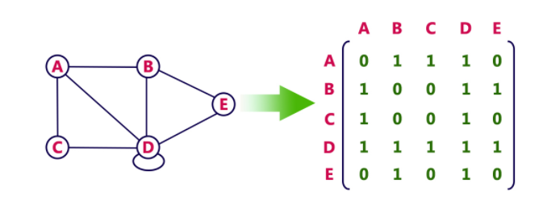
Adjacency Matrix – Undirected

Slide 20
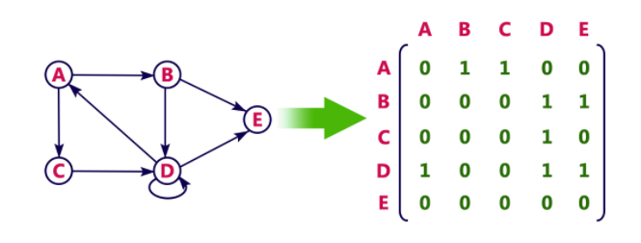
Adjacency Matrix - Directed

Slide 21
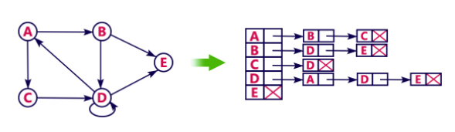
Adjacency List – Using Linked List

Slide 22
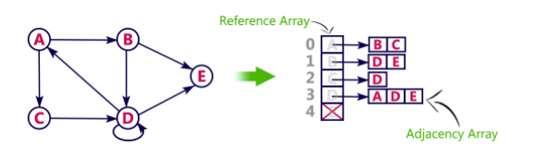
Adjacency List – Using array

Slide 23
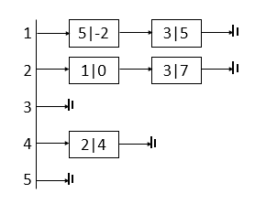
Draw a adjacency matrix / list
- Calculate indegree/out degree of each node
1
5
3
0
-2
2
7
5
4
4
s\t | 1 | 2 | 3 | 4 | 5
1 | 0 | 0 | 5 | 0 | -2
2 | 0 | 0 | 7 | 0 | 0
3 | 0 | 0 | 0 | 0 | 0
4 | 0 | 4 | 0 | 0 | 0
5 | 0 | 0 | 0 | 0 | 0

Slide 24
Graph Traversal
DFS (Depth First Search)
BFS (Breadth First Search)
Queue
Stack

Slide 25
Background
Visited - Array
Explored
  Queue - BFS
  Stack - DFS

Slide 26
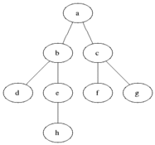
BFS
BFS traversal of a graph, produces a spanning tree as final result.
Spanning Tree is a graph without any loops.
Queue data structure with maximum size of total number of vertices in the graph to implement BFS traversal of a graph.

Slide 27
Procedure
Step 1: Define a Queue of size total number of vertices in the graph.
Step 2: Select any vertex as starting point for traversal. Visit that vertex and insert it into the Queue.
Step 3: Visit all the adjacent vertices of the vertex which is at front of the Queue which is not visited and insert them into the Queue.
Step 4: When there is no new vertex to be visit from the vertex at front of the Queue then delete that vertex from the Queue.
Step 5: Repeat step 3 and 4 until queue becomes empty.
Step 6: When queue becomes Empty, then produce final spanning tree by removing unused edges from the graph

Slide 28
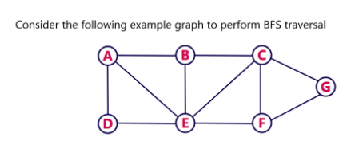
Example

Slide 29
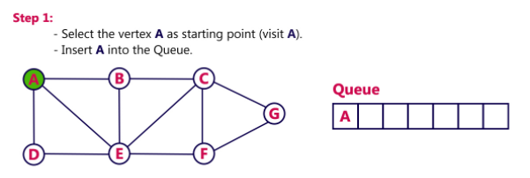
BFS

Slide 30
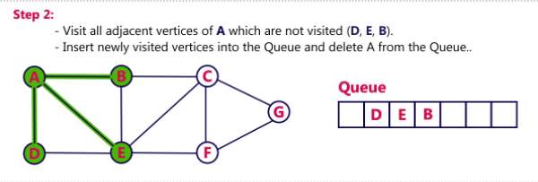
BFS

Slide 31
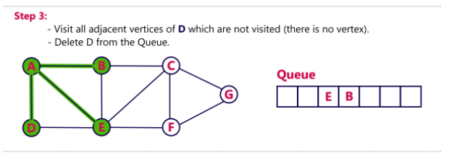
BFS

Slide 32
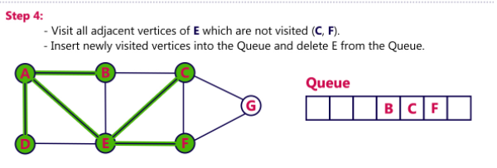
BFS

Slide 33
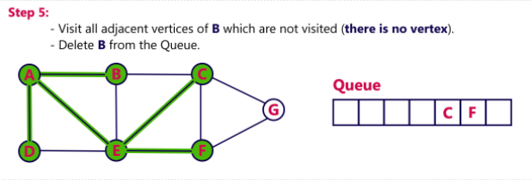
BFS

Slide 34
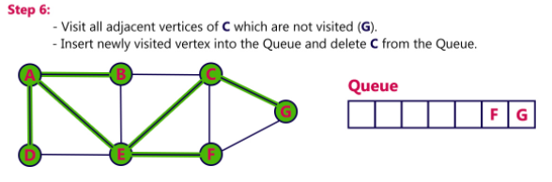
BFS

Slide 35
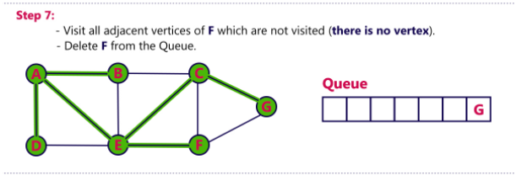
BFS

Slide 36
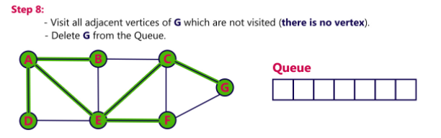
BFS

Slide 37
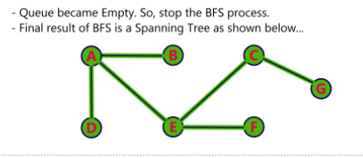
BFS

Slide 38
Procedure
Step 1: Define a Queue of size total number of vertices in the graph.
Step 2: Select any vertex as starting point for traversal. Visit that vertex and insert it into the Queue.
Step 3: Visit all the adjacent vertices of the vertex which is at front of the Queue which is not visited and insert them into the Queue.
Step 4: When there is no new vertex to be visit from the vertex at front of the Queue then delete that vertex from the Queue.
Step 5: Repeat step 3 and 4 until queue becomes empty.
Step 6: When queue becomes Empty, then produce final spanning tree by removing unused edges from the graph

Slide 39
Procedure
BFS (G, s) //Where G is the graph and s is the source node
let Q be queue.
Q.enqueue( s ) //Inserting s in queue until all its neighbour vertices are marked.
mark s as visited.
while ( Q is not empty)
//Removing that vertex from queue, whose neighbour will be visited now
v = Q.dequeue( )
//processing all the neighbours of v
for all neighbours w of v in Graph G
if w is not visited
Q. enqueue( w ) //Stores w in Q to further visit its neighbour
mark w as visited.

Slide 40
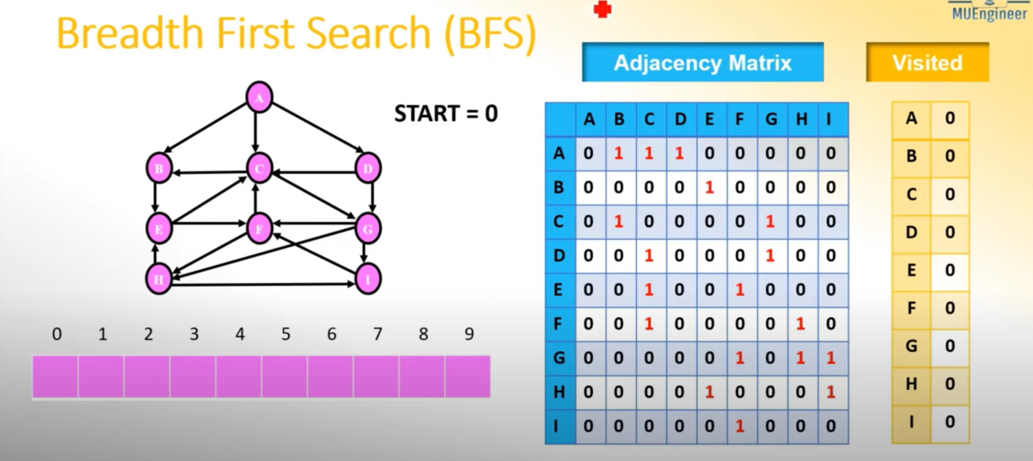

Slide 41
IMPLEMENTATION
Void BFS(int adj[Max][max],int visited[],int start)
{
Int queue[max],rear=front=-1,I,k;
For(k=0; k<max; k++)
{
Visited[k]=0;
}
Queue[++rear]=start;
++front;
Visited[start]=1;
While(rear>=front)
{
Start=queue[front++];
Printf(“%c”,start+65);
For(i=0;i<max;i++)
{
If(adj[start][i] && visited[i]=0)
{
Queue[++rear]=I;
Visited[i]=1;
}
}
}
}

Slide 42
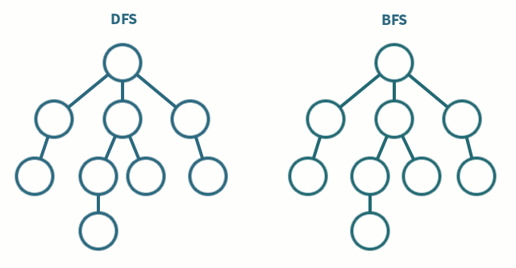
DFS
DFS traversal of a graph, produces a spanning tree as final result.
Spanning Tree is a graph without any loops.
Stack data structure with maximum size of total number of vertices in the graph to implement DFS traversal of a graph.

Slide 43
DFS traversal
Step 1: Define a Stack of size total number of vertices in the graph.
Step 2: Select any vertex as starting point for traversal. Visit that vertex and push it on to the Stack.
Step 3: Visit any one of the adjacent vertex of the vertex which is at top of the stack which is not visited and push it on to the stack.
Step 4: Repeat step 3 until there are no new vertex to be visit from the vertex on top of the stack.
Step 5: When there is no new vertex to be visit then use back tracking and pop one vertex from the stack.
Step 6: Repeat steps 3, 4 and 5 until stack becomes Empty.
Step 7: When stack becomes Empty, then produce final spanning tree by removing unused edges from the graph
Back tracking is coming back to the vertex from which we came to current vertex.

Slide 44
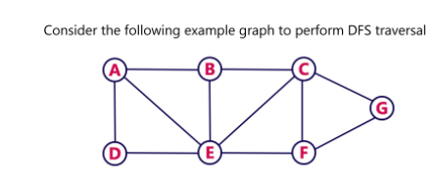
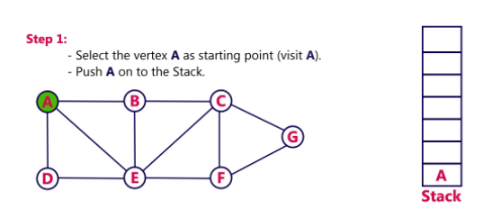
DFS

Slide 45
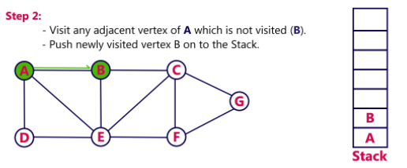
DFS

Slide 46
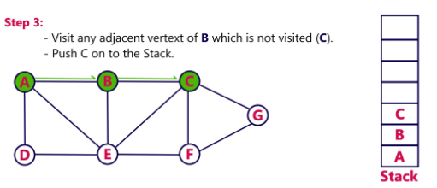
DFS

Slide 47
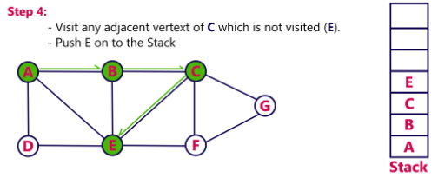
DFS

Slide 48
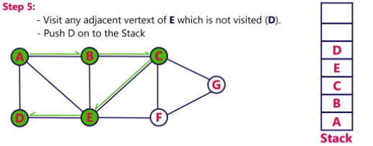
DFS

Slide 49
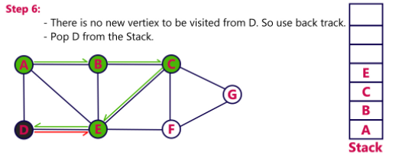
DFS

Slide 50
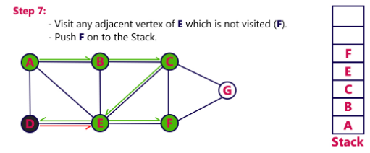
DFS

Slide 51
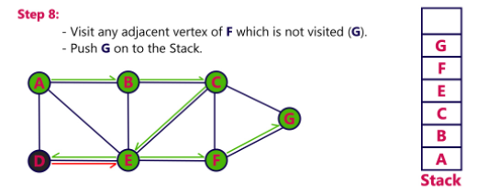
DFS

Slide 52
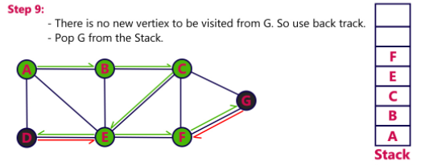
DFS

Slide 53
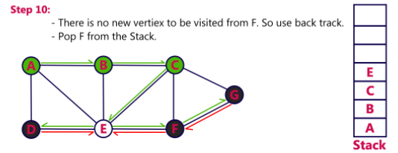
DFS

Slide 54
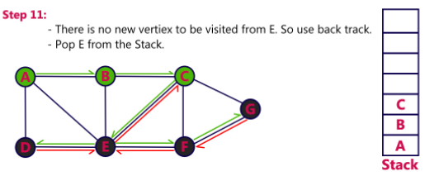
DFS

Slide 55
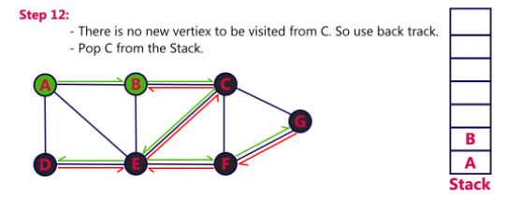
DFS

Slide 56
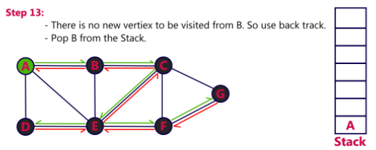
DFS

Slide 57
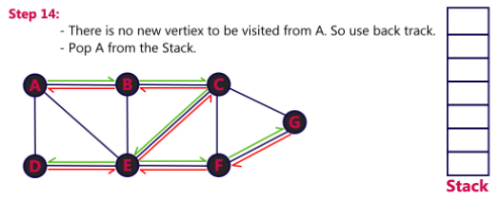
DFS

Slide 58
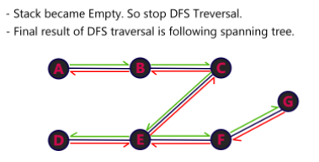
DFS

Slide 59
DFS traversal
Step 1: Define a Stack of size total number of vertices in the graph.
Step 2: Select any vertex as starting point for traversal. Visit that vertex and push it on to the Stack.
Step 3: Visit any one of the adjacent vertex of the vertex which is at top of the stack which is not visited and push it on to the stack.
Step 4: Repeat step 3 until there are no new vertex to be visit from the vertex on top of the stack.
Step 5: When there is no new vertex to be visit then use back tracking and pop one vertex from the stack.
Step 6: Repeat steps 3, 4 and 5 until stack becomes Empty.
Step 7: When stack becomes Empty, then produce final spanning tree by removing unused edges from the graph
Back tracking is coming back to the vertex from which we came to current vertex.

Slide 60
Procedure
DFS-iterative (G, s): //Where G is graph and s is source vertex
let S be stack
S.push( s ) //Inserting s in stack
mark s as visited.
while ( S is not empty):
//Pop a vertex from stack to visit next
v = S.top( )
S.pop( )
//Push all the neighbours of v in stack that are not visited
for all neighbours w of v in Graph G:
if w is not visited :
S.push( w )
mark w as visited
DFS-recursive(G, s):
mark s as visited
for all neighbours w of s in Graph G:
if w is not visited:
DFS-recursive(G, w)

Slide 61
IMPLEMENTATION
Void dfs(int adj[max][max],int visited[],int start)
{
Int stack[max];
Int top=-1,I,k;
For(k=0;k<max;k++)
Visited[k]=0;
Stack[++top]=start;
Visited[start]=1
While(top!=-1)
{
Start=start[top--];
Printf(“%c”,start+65);
For(i=0;i<max;i++)
{
If(adj[start][i] && visited[i]==0)
{
Stack[++top]=i;
Visited[i]=1;
Break;
}
}
}
}

Slide 62
Spanning Trees
A spanning tree of a graph is just a subgraph that contains all the vertices and is a tree.
A graph may have many spanning trees.
Graph A
Some Spanning Trees from Graph A
or
or
or

Slide 63
Complete Graph
All 16 of its Spanning Trees

Slide 64
Minimum Spanning Trees
The Minimum Spanning Tree for a given graph is the Spanning Tree of minimum cost for that graph.
Complete Graph
Minimum Spanning Tree
7
2
2
5
3
3
4
1
1

Slide 65
Problem: Laying Telephone Wire
Central office

Slide 66
Wiring: Naïve Approach
Central office
Expensive!

Slide 67
Wiring: Better Approach
Central office
Minimize the total length of wire connecting the customers

Slide 68
Algorithms for Obtaining the Minimum Spanning Tree
Kruskal's Algorithm
Prim's Algorithm

Slide 69
Minimum Spanning Tree
Kruskal’s algorithm
Select the shortest edge in a network
Select the next shortest edge which does not create a cycle
Repeat step 2 until all vertices have been connected
Prim’s algorithm
Select any vertex
Select the shortest edge connected to that vertex
Select the shortest edge connected to any vertex already connected
Repeat step 3 until all vertices have been connected

Slide 70
Example
B
5
C
3
4
8
6
8
A
F
D
7
5
4
2
E

Slide 71
Kruskal’s Algorithm
List the edges in order of size:
ED 2
AB 3
AE 4
CD 4
BC 5
EF 5
CF 6
AF 7
BF 8
CF 8
B
5
C
3
4
8
6
8
A
D
7
F
5
4
2
E

Slide 72
Kruskal’s Algorithm
Select the shortest
edge in the network
ED 2
B
5
C
3
4
8
6
8
A
D
7
F
5
4
2
E

Slide 73
Kruskal’s Algorithm
Select the next shortest
edge which does not
create a cycle
ED 2
AB 3
B
5
C
3
4
8
6
8
A
D
7
F
5
4
2
E

Slide 74
Kruskal’s Algorithm
Select the next shortest
edge which does not
create a cycle
ED 2
AB 3
CD 4 (or AE 4)
B
5
C
3
4
8
6
8
A
D
7
F
5
4
2
E

Slide 75
Kruskal’s Algorithm
Select the next shortest
edge which does not
create a cycle
ED 2
AB 3
CD 4
AE 4
B
5
C
3
4
8
6
8
A
D
7
F
5
4
2
E

Slide 76
Kruskal’s Algorithm
Select the next shortest
edge which does not
create a cycle
ED 2
AB 3
CD 4
AE 4
BC 5 – forms a cycle
EF 5
B
5
C
3
4
8
6
8
A
D
7
F
5
4
2
E

Slide 77
Kruskal’s Algorithm
All vertices have been
connected.
The solution is
ED 2
AB 3
CD 4
AE 4
EF 5
Total weight of tree: 18
B
5
C
3
4
8
6
8
A
D
7
F
5
4
2
E

Slide 78
Complete Graph
B
4
C
4
2
1
A
4
E
1
F
D
2
3
10
G
5
5
6
3
4
I
H
2
3
J

Slide 79
A
4
B
A
1
D
B
4
C
B
4
D
B
4
C
B
10
J
C
2
E
4
2
1
C
1
F
D
5
H
A
4
E
1
F
2
D
6
J
E
2
G
D
3
10
G
5
F
3
G
F
5
I
5
6
3
4
I
G
3
I
G
4
J
H
2
3
J
H
2
J
I
3
J

Slide 80
Sort Edges
(in reality they are placed in a priority queue - not sorted - but sorting them makes the algorithm easier to visualize)
1
1
A
D
C
F
C
2
E
E
2
G
B
4
C
H
2
J
F
3
G
4
2
1
G
3
I
I
3
J
A
4
E
1
F
2
A
4
B
B
4
D
D
3
10
G
5
B
4
C
G
4
J
5
6
3
4
I
F
5
I
D
5
H
H
2
3
J
D
6
J
B
10
J

Slide 81
Add Edge
1
1
A
D
C
F
C
2
E
E
2
G
B
4
C
H
2
J
F
3
G
4
2
1
G
3
I
I
3
J
A
4
E
1
F
2
A
4
B
B
4
D
D
3
10
G
5
B
4
C
G
4
J
5
6
3
4
I
F
5
I
D
5
H
H
2
3
J
D
6
J
B
10
J

Slide 82
Add Edge
1
1
A
D
C
F
C
2
E
E
2
G
B
4
C
H
2
J
F
3
G
4
2
1
G
3
I
I
3
J
A
4
E
1
F
2
A
4
B
B
4
D
D
3
10
G
5
B
4
C
G
4
J
5
6
3
4
I
F
5
I
D
5
H
H
2
3
J
D
6
J
B
10
J

Slide 83
Add Edge
1
1
A
D
C
F
C
2
E
E
2
G
B
4
C
H
2
J
F
3
G
4
2
1
G
3
I
I
3
J
A
4
E
1
F
2
A
4
B
B
4
D
D
3
10
G
5
B
4
C
G
4
J
5
6
3
4
I
F
5
I
D
5
H
H
2
3
J
D
6
J
B
10
J

Slide 84
Add Edge
1
1
A
D
C
F
C
2
E
E
2
G
B
4
C
H
2
J
F
3
G
4
2
1
G
3
I
I
3
J
A
4
E
1
F
2
A
4
B
B
4
D
D
3
10
G
5
B
4
C
G
4
J
5
6
3
4
I
F
5
I
D
5
H
H
2
3
J
D
6
J
B
10
J

Slide 85
Add Edge
1
1
A
D
C
F
C
2
E
E
2
G
B
4
C
H
2
J
F
3
G
4
2
1
G
3
I
I
3
J
A
4
E
1
F
2
A
4
B
B
4
D
D
3
10
G
5
B
4
C
G
4
J
5
6
3
4
I
F
5
I
D
5
H
H
2
3
J
D
6
J
B
10
J

Slide 86
Cycle
Don’t Add Edge
1
1
A
D
C
F
C
2
E
E
2
G
B
4
C
H
2
J
F
3
G
4
2
1
G
3
I
I
3
J
A
4
E
1
F
2
A
4
B
B
4
D
D
3
10
G
5
B
4
C
G
4
J
5
6
3
4
I
F
5
I
D
5
H
H
2
3
J
D
6
J
B
10
J

Slide 87
Add Edge
1
1
A
D
C
F
C
2
E
E
2
G
B
4
C
H
2
J
F
3
G
4
2
1
G
3
I
I
3
J
A
4
E
1
F
2
A
4
B
B
4
D
D
3
10
G
5
B
4
C
G
4
J
5
6
3
4
I
F
5
I
D
5
H
H
2
3
J
D
6
J
B
10
J

Slide 88
Add Edge
1
1
A
D
C
F
C
2
E
E
2
G
B
4
C
H
2
J
F
3
G
4
2
1
G
3
I
I
3
J
A
4
E
1
F
2
A
4
B
B
4
D
D
3
10
G
5
B
4
C
G
4
J
5
6
3
4
I
F
5
I
D
5
H
H
2
3
J
D
6
J
B
10
J

Slide 89
Add Edge
1
1
A
D
C
F
C
2
E
E
2
G
B
4
C
H
2
J
F
3
G
4
2
1
G
3
I
I
3
J
A
4
E
1
F
2
A
4
B
B
4
D
D
3
10
G
5
B
4
C
G
4
J
5
6
3
4
I
F
5
I
D
5
H
H
2
3
J
D
6
J
B
10
J

Slide 90
Cycle
Don’t Add Edge
1
1
A
D
C
F
C
2
E
E
2
G
B
4
C
H
2
J
F
3
G
4
2
1
G
3
I
I
3
J
A
4
E
1
F
2
A
4
B
B
4
D
D
3
10
G
5
B
4
C
G
4
J
5
6
3
4
I
F
5
I
D
5
H
H
2
3
J
D
6
J
B
10
J

Slide 91
Add Edge
1
1
A
D
C
F
C
2
E
E
2
G
B
4
C
H
2
J
F
3
G
4
2
1
G
3
I
I
3
J
A
4
E
1
F
2
A
4
B
B
4
D
D
3
10
G
5
B
4
C
G
4
J
5
6
3
4
I
F
5
I
D
5
H
H
2
3
J
D
6
J
B
10
J

Slide 92
Minimum Spanning Tree
Complete Graph
B
4
C
4
B
C
4
4
2
1
2
1
A
E
A
4
1
F
E
F
1
D
2
2
D
3
10
G
G
5
3
5
6
3
4
I
I
H
H
2
3
3
J
2
J

Slide 93
Analysis of Kruskal's Algorithm
Running Time = O(m log n) (m = edges, n = nodes)

Slide 94
Minimum Spanning Tree
Kruskal’s algorithm
Select the shortest edge in a network
Select the next shortest edge which does not create a cycle
Repeat step 2 until all vertices have been connected
Prim’s algorithm
Select any vertex
Select the shortest edge connected to that vertex
Select the shortest edge connected to any vertex already connected
Repeat step 3 until all vertices have been connected

Slide 95
Prim’s Algorithm
Select any vertex
A
Select the shortest edge connected to that vertex
AB 3
B
5
C
3
4
8
6
8
A
D
7
F
5
4
2
E

Slide 96
Prim’s Algorithm
Select the shortest
edge connected to
any vertex already
connected.
AE 4
B
5
C
3
4
8
6
8
A
D
7
F
5
4
2
E

Slide 97
Prim’s Algorithm
Select the shortest
edge connected to
any vertex already
connected.
ED 2
B
5
C
3
4
8
6
8
A
D
7
F
5
4
2
E

Slide 98
Prim’s Algorithm
Select the shortest
edge connected to
any vertex already
connected.
DC 4
B
5
C
3
4
8
6
8
A
D
7
F
5
4
2
E

Slide 99
Prim’s Algorithm
Select the shortest
edge connected to
any vertex already
connected.
EF 5
1
5
C
3
4
8
6
8
0
D
7
F
5
4
2
E

Slide 100
Prim’s Algorithm
All vertices have been
connected.
The solution is
AB 3
AE 4
ED 2
DC 4
EF 5
Total weight of tree: 18
B
5
C
3
4
8
6
8
A
D
7
F
5
4
2
E

Slide 101
Prim's Algorithm
This algorithm starts with one node. It then, one by one, adds a node that is unconnected to the new graph to the new graph, each time selecting the node whose connecting edge has the smallest weight out of the available nodes’ connecting edges.

Slide 102
The steps are:
1. The new graph is constructed - with one node from the old graph.
2. While new graph has fewer than n nodes,
1. Find the node from the old graph with the smallest connecting edge to the new graph,
2. Add it to the new graph
Every step will have joined one node, so that at the end we will have one graph with all the nodes and it will be a minimum spanning tree of the original graph.

Slide 103
Complete Graph
B
4
C
4
2
1
A
4
E
1
F
D
2
3
10
G
5
5
6
3
4
I
H
2
3
J

Slide 104
Old Graph
New Graph
B
4
C
4
B
4
C
2
1
4
2
1
A
4
E
1
F
A
4
E
F
1
D
2
3
10
D
2
3
G
5
10
G
5
5
6
3
5
6
3
4
I
4
H
I
3
H
2
J
2
3
J

Slide 105
Old Graph
New Graph
B
4
C
4
B
4
C
2
1
4
2
1
A
4
E
1
F
A
4
E
F
1
D
2
3
10
D
2
3
G
5
10
G
5
5
6
3
5
6
3
4
I
4
H
I
3
H
2
J
2
3
J

Slide 106
Old Graph
New Graph
B
4
C
4
B
4
C
2
1
4
2
1
A
4
E
1
F
A
4
E
F
1
D
2
3
10
D
2
3
G
5
10
G
5
5
6
3
5
6
3
4
I
4
H
I
3
H
2
J
2
3
J

Slide 107
Old Graph
New Graph
B
4
C
4
B
4
C
2
1
4
2
1
A
4
E
1
F
A
4
E
F
1
D
2
3
10
D
2
3
G
5
10
G
5
5
6
3
5
6
3
4
I
4
H
I
3
H
2
J
2
3
J

Slide 108
Old Graph
New Graph
B
4
C
4
B
4
C
2
1
4
2
1
A
4
E
1
F
A
4
E
F
1
D
2
3
10
D
2
3
G
5
10
G
5
5
6
3
5
6
3
4
I
4
H
I
3
H
2
J
2
3
J

Slide 109
Old Graph
New Graph
B
4
C
4
B
4
C
2
1
4
2
1
A
4
E
1
F
A
4
E
F
1
D
2
3
10
D
2
3
G
5
10
G
5
5
6
3
5
6
3
4
I
4
H
I
3
H
2
J
2
3
J

Slide 110
Old Graph
New Graph
B
4
C
4
B
4
C
2
1
4
2
1
A
4
E
1
F
A
4
E
F
1
D
2
3
10
D
2
3
G
5
10
G
5
5
6
3
5
6
3
4
I
4
H
I
3
H
2
J
2
3
J

Slide 111
Old Graph
New Graph
B
4
C
4
B
4
C
2
1
4
2
1
A
4
E
1
F
A
4
E
F
1
D
2
3
10
D
2
3
G
5
10
G
5
5
6
3
5
6
3
4
I
4
H
I
3
H
2
J
2
3
J

Slide 112
Old Graph
New Graph
B
4
C
4
B
4
C
2
1
4
2
1
A
4
E
1
F
A
4
E
F
1
D
2
3
10
D
2
3
G
5
10
G
5
5
6
3
5
6
3
4
I
4
H
I
3
H
2
J
2
3
J

Slide 113
Old Graph
New Graph
B
4
C
4
B
4
C
2
1
4
2
1
A
4
E
1
F
A
4
E
F
1
D
2
3
10
D
2
3
G
5
10
G
5
5
6
3
5
6
3
4
I
4
H
I
3
H
2
J
2
3
J

Slide 114
Complete Graph
Minimum Spanning Tree
B
4
C
4
B
4
C
2
1
4
2
1
A
4
E
1
F
A
E
F
1
D
2
3
10
D
2
G
5
G
5
6
3
3
4
I
H
I
3
H
2
J
2
3
J

Slide 115
Analysis of Prim's Algorithm
Running Time = O(m + n log n) (m = edges, n = nodes)
For this algorithm the number of nodes needs to be kept to a minimum in addition to the number of edges. For small graphs, the edges matter more, while for large graphs the number of nodes matters more.

Slide 116
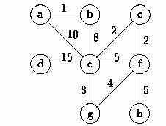
Trace Prim’s & Kruskal to find MST

Slide 117
